Slide 1
RAISING THE BAR ON ENERGY EFFICIENCY: BUILDING ENERGY CODES, APPLIANCE STANDARDS AND BUILDING ENERGY RATING
Presented by
JIM O’REILLY
June 18, 2010
To the New England Restructuring Roundtable

Slide 2
NORTHEAST ENERGY EFFICIENCY PARTNERSHIPS “Accelerating Energy Efficiency”
MISSION
Accelerate the efficient use of energy in the Northeast
and Mid-Atlantic Regions
APPROACH
Overcome barriers to efficiency through
Collaboration, Education & Advocacy
VISION
Transform the way we think about
and use energy in the world around us.

Slide 3
CODES/STANDARDS BECOMING A PRIORITY
AGGRESSIVE NEW GOALS BEING SET IN STATES
IDENTIFIED NEED TO GO BROADER, DEEPER
CODES EMPHASIZED IN FEDERAL STIMULUS (ARRA), STANDARDS BY THE NEW ADMINISTRATION
CODES/STANDARDS BECOMING PART OF SBC PROGRAMS (MASS, CT)
COMPLEMENT EE PROGRAMS

Slide 4
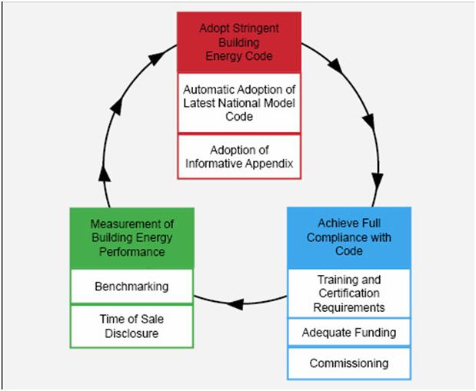
Efficiency PROGRAMS SUPPORT CODES AND STANDARDS
APPLIANCE STANDARDS
BUILDING ENERGY CODES
Federal Considers State Standards
Federal Standards Preempt States
States Adopt Appliance Standards
Programs Build Market Acceptance
Consumer Products

Slide 5
BUILDING ENERGY CODES - BASICS
Provide minimum building requirements that are cost-effective in saving energy
Required for new construction or substantial renovation
DEVELOPMENT
Nationally, private model code organizations – IECC, ASHRAE – develop technically supported codes through consensus process
ADOPTION
Most states adopt those model codes either legislatively or administratively, many with state specifications
IMPLEMENTATION
Code inspection and enforcement generally occurs through local building officials
Notes:
- Whole building approach: all states now have some kind of whole building residential programs, most often labeled as Home Performance with ENERGY STAR, but in some states (e.g., CT and NH), it’s under a different name. On commercial, all are at least trying to get more comprehensive to address all fuels. For example, strategy in most states is evolving from simple lighting retrofits to audit-driven, lost opportunity approaches that also consider related heating/cooling improvements. Are also trying to do more O&M retrocommissioning, but PAs are still wary of how they’ll be viewed from a cost-effectiveness perspective by regulators (see slide 9)
-CHP information from ACEEE: http://www.aceee.org/industry/Chittum_IETC_09_CHP_Scorecard_1.pdf
- On decoupling: see accompanying cheat sheet thumbnail descriptions of various state decoupling policies.

Slide 6
NATIONAL MODEL CODES
IECC
2009 in place, state adoptions now
‘30 % Solution’
2012 in development
ASHRAE 90.1 2010
Update underway, publication expected this fall
Also developed advanced buildings guideline ‘Standard 189’
DOE urging updates to meet net zero building milestones toward 2025 goal of ‘marketable’ NZEBs

Slide 7
THE BOOST FROM ARRA
AMERICAN RECOVERY AND REINVESTMENT ACT (ARRA)
Conditioning language for SEP grant eligibility:
Adopt 2009 IECC (residential)
Adopt 2007 ASHARE 90.1 (commercial)
Develop plan to achieve 90 percent code compliance within eight years
Some states have enacted legislation demonstrating ARRA code requirements (VT, RI, DE)
Many using ARRA SEP funds – at varying levels – to develop/enhance code training (NH, MA, CT, RI, ME, NY)

Slide 8
STATUS OF ENERGY CODES
State | Residential | Commercial | Notes
Connecticut | 2003 IRC | 2003 IECC | Update to 2009 pending
Maine | 2009 IECC pending | 2009 IECC pending | First uniform statewide code; third party inspection
Massachusetts | IECC 2009 | ASHRAE 90.1-2007 or 2009 IECC | Effective June 1; automatic update mandated
New Hampshire | 2009 IECC | 2009 IECC | Effective April 1
New Jersey | 2006 IECC | 2006 IECC | Update on hold
New York | 2009 IECC | ASHRAE 90.1-2007 | Adopted April 2010
Rhode Island | 2009 IECC pending | 2009 IECC pending | Effective July 1
Vermont | 2000 IECC w/amendments | 2006 IECC | Update to latest model code mandated by 1/11

Slide 9
ENERGY CODES POLICY: ISSUES TO ADDRESS
CODE ADOPTION
ARRA commitments aside, are states serious?
More well-funded opposition to model code development
Confusion re: beyond code/green building guidance
CODE COMPLIANCE
Just figuring out compliance levels is a challenge
Often ignored, focus more on health/safety codes
State, municipal code offices, training efforts underfunded
Tracking virtually non-existent
MEASUREMENT
Post construction energy performance largely ignored
GUIDANCE
NEEP Model Progressive Building Energy Codes Policy

Slide 10
Building energy labeling/disclosure
MEASURING/DISCLOSING BUILDING ENERGY PERFORMANCE
Time-of-sale (or other event) rating and disclosure
Code addresses new construction, BER gets to existing
High interest in states
NEEP research paper developed
Provides roadmap for states in setting policies
Working with new federal on establishing the rating system
Working with states to set up policy infrastructure
http://neep.org/public-policy/building-energy-codes/building-energy-rating

Slide 11
Building energy labeling/disclosure
MEASURING/DISCLOSING BUILDING ENERGY PERFORMANCE
Many experiences nationally/internationally to draw from
Examines policy design issues
Fall ‘09: DOE-EPA reorganize, DOE to lead new National Building Rating Project to develop unified rating system
Key issues for comment:
Building national registry\database – privacy issues?
Asset or operational rating?
Site or source energy?
Link to new retrofit efforts – mandated upgrades?

Slide 12
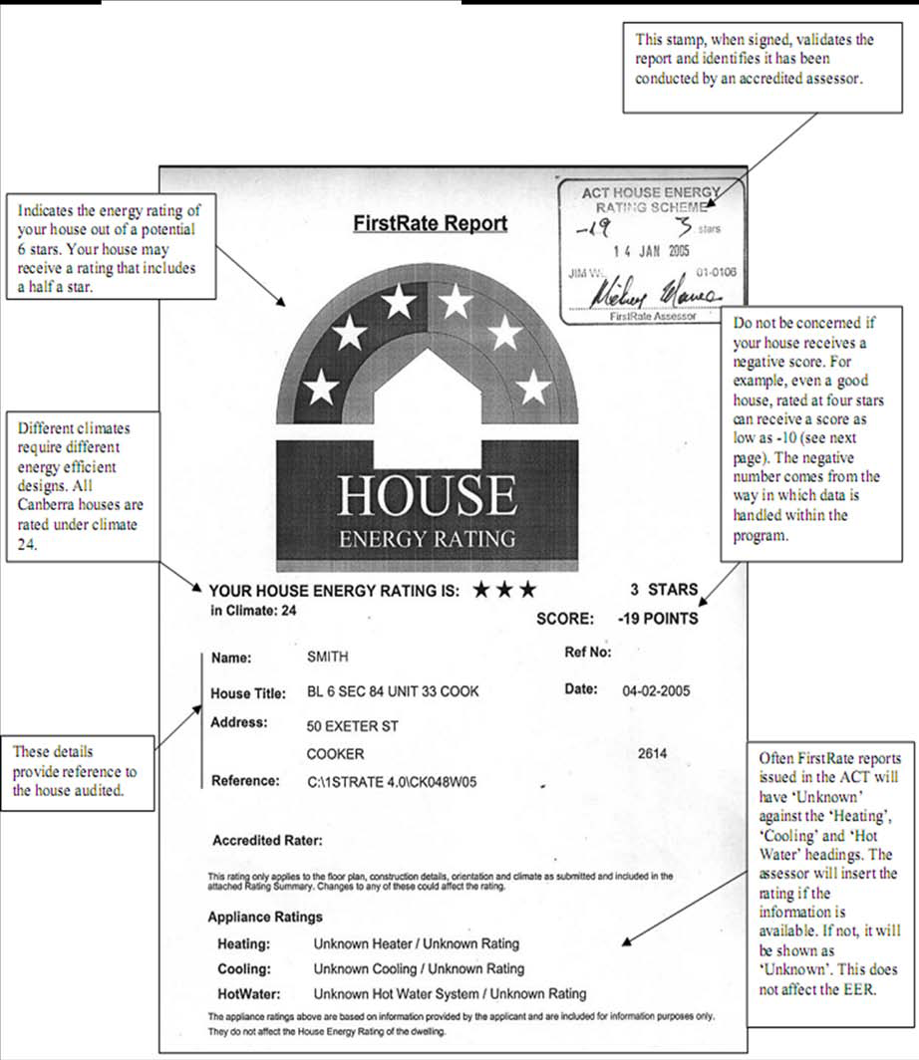
BUILDING RATING MODELS

Slide 13
Appliance standards
Provide minimum energy requirements for manufacture, import, sale or installation of an array of consumer products
Can be set nationally or by states, but federal trumps
HISTORY
- Beginning in late ‘70s, states drove federal action, resulting in dozens of new appliance standards through 2007
TODAY
- President setting aggressive new standards policy federally
- States driving federal furnace standard, with Mass. in the lead
- California once again leads new product list, topped by TVs
- Mass., Conn., N.Y., Maryland, Washington following
- Fierce opposition from consumer electronics industry

Slide 14
The case for standards - illustrated
Notes:
- Whole building approach: all states now have some kind of whole building residential programs, most often labeled as Home Performance with ENERGY STAR, but in some states (e.g., CT and NH), it’s under a different name. On commercial, all are at least trying to get more comprehensive to address all fuels. For example, strategy in most states is evolving from simple lighting retrofits to audit-driven, lost opportunity approaches that also consider related heating/cooling improvements. Are also trying to do more O&M retrocommissioning, but PAs are still wary of how they’ll be viewed from a cost-effectiveness perspective by regulators (see slide 9)
-CHP information from ACEEE: http://www.aceee.org/industry/Chittum_IETC_09_CHP_Scorecard_1.pdf
- On decoupling: see accompanying cheat sheet thumbnail descriptions of various state decoupling policies.

Slide 15
CODES AND STANDARDS: ISSUES TO ADDRESS
ATTRIBUTION ➔ who gets credit for:
Energy code updates
Code training/support
New appliance standards
RISING BASELINES ➔ need:
New sources of savings
Transition strategies
Incentives to innovate
Different cost-effectiveness screening

Slide 16
THANK YOU
JIM O’REILLY
Director of Public Policy
joreilly@neep.org
91 Hartwell Avenue Lexington, MA 02421
P: 781.860.9177
www.neep.org

